Slide 1
An online exam proposal
20 November 2019

Slide 2
Limitation of Online Exam
Technically infeasible to verify the identity of the students.
Students will be allowed to download and keep the examination paper and this is inappropriate for some "non-circulation paper".
It is impossible to prohibit any discussion among students during the examination via different means of communication. e.g. Whatsapp, Wechat, Skype, etc.
Student may share their answers with each other.
The current solution is unable to address the issue of searching of solution through the internet and is therefore limited to open book examination only.
Students around the world will have to sit the examination at the same start time and thus create unfairness due to different time zone.

Slide 3
Limitation of Online Exam
Disputes may arise as the end time of the examination cannot be controlled while the arrival time of answer from student is network dependent.
Students with Special Educational Needs cannot be served as they may have different time arrangement in general.
Extensive resources may have to deploy to support the examination during the online session for any unforeseeable problems/questions from students.
Turnitin, which guards against direct copying and plagiarism, cannot be used in submitting the answers in online exams.
Students are not able to arise questions from the exam paper to the examiner within the first 30 minutes of the examination accordingly to current practice.
Any amendments on exam paper cannot be communicated to all students immediately.

Slide 4
Online Exam proposal
– Executive Summary
Background:
All SIS courses have corresponding Moodle courses created even if they are not activated
Online exam will take place by login the corresponding Moodle course at the Scheduled exam timeslot (from start to end time & date)
User interface design:
In each Moodle course page, on the Right Hand Side, it will show 3 links in a so-called Moodle Block titled “Online Exam”:
Instruction to students taking Online Exam
Instruction on submitting answer sheets to the course exam_email_account
Download Exam Paper in PDF { only downloadable during the Scheduled exam timeslot }

Slide 5
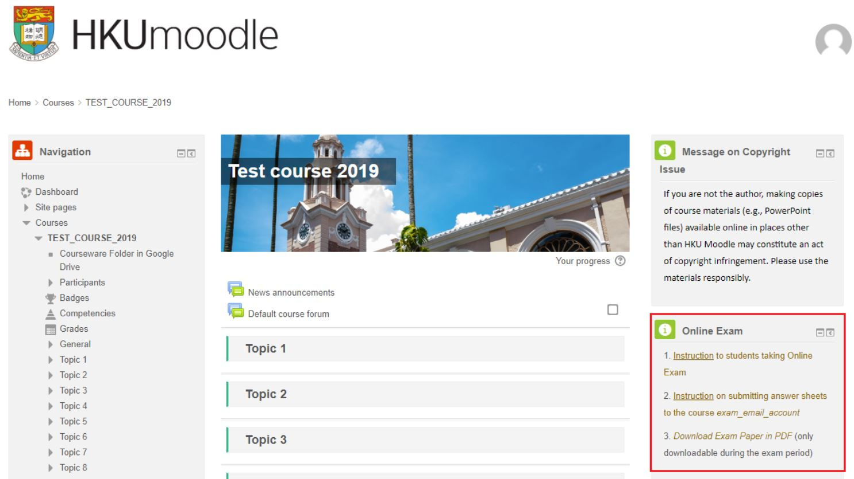

Slide 6
Major tasks of different work units to prepare for Online Exam
Chief Invigilator (CI) (or designate) of an SIS course with online exam
  The CI is the prime teacher of an SIS course according to the SIS information
Exam Office
ITS
…

Slide 7
(A) Major tasks of Chief Invigilator or designate (CI) of an SIS course
Before online exam – CI, with technical support from the Faculty IT people, preload the Exam Paper for the SIS course to a special folder on a special ITS server
At the start of online exam – CI enable showing the link for students in the course to download the exam paper – by clicking a button on a special webpage ‘T’ on a special ITS Server
  The System disallows the download after the end of the online exam
During online exam –
  Students follow the instruction (prepared by Exam Office) to take the online exam
  CI & staff answer students’ inquiries over the communication channels (a special email address, phone, etc.) (TBC)
Example inquiries: (FAQ will be prepared)
  I cannot download the exam paper (=> arrange supplementary exam for him)
  I have submitted answer sheets by email but no acknowledgement (=> check email address, re-sent the same answer sheet after 1 minute)
Note:
The answer sheets should not exceed 25MB (students using @connect.hku.hk is limited to sending an email size up to 25MB including attachments)
FAQ will be prepared

Slide 8
(B) Major tasks of Exam Office (1)
Prepare for the instructions of the 2 links on the Moodle Block “Online Exam”
  Instruction to students taking Online Exam
  Instruction on submitting answer sheets to the course exam_email_account
Coordinate with the prime course instructor (assumed also as the Chief Invigilator (CI)) to designate the CI role to a colleague
Coordinate with departmental IT staff/ programme administrators in assisting CI to pre-load the exam paper (a PDF file) to a folder in an ITS system (EX).
Train the CI to start an online exam
  By clicking a button on a special webpage ‘T’ to start the online exam which will run till the scheduled duration. (If start a bit later, the allowed download of the exam paper will end a bit later for the same period.)
Inform and remind students about the instructions [see above a)1 and a)2]

Slide 9
(B) Major tasks of Exam Office (2)
Instruction to the students:
  Remind students to submit answer sheets to the course exam email account before the end of the Scheduled exam timeslot.
  The first submitted answer sheets by email attachment to the course exam email account is regarded as the submission. An acknowledgement email will be sent back to the student’s sending e-address and the HKU e-address when the submission email is received at the course exam email account
    Examples of the answer sheets
    photos taken by a student of their written answer
    A Microsoft WORD file in which the student fills in the answers.
  Students have to keep the time of the end of the Scheduled exam timeslot.

Slide 10
(C) Major tasks of ITS
Make the Moodle Block “Online Exam” work on Moodle system for every Course with Online Exam
  Make the link #3 “Download Exam Paper in PDF” effective upon the Chief Invigilator clicking a button on a special webpage T prepared by ITS.
  Stop the Download after the duration of the Scheduled exam timeslot
Before start of the Scheduled exam timeslot –
  Create the course-based exam_email_account for Chief Invigilator (or designate, e.g. other instructor/programme administrators) for collecting exam answer sheets
  Assist Exam Office to provide training for Chief Invigilators and other supporting staff in departments

Slide 11
Drill before Scheduled exam timeslot (1)
Instructions to students taking Online Exam
On a mock-up Moodle Course, show 3 links in the Moodle Block “Online Exam”
  Instruction to students taking Online Exam
  Instruction on submitting answer sheets to the course exam_email_account
  Download Exam Paper in PDF { only downloadable during the Scheduled exam timeslot }
Students can assess it to read the instructions
Students clicking Link 3 can only see a message about downloading the exam paper from their Moodle Course during the Scheduled exam timeslot
No time-up or submission alert will be provided. Students have to do their own time-keeping.
After the online exam,
Students should follow the instruction to “submit the answer sheets to the course-based exam_email_account ” - by sending email using their HKU Portal email or other email address – to submit the answer sheets as attachment
  the answer sheets must have the student no., course code written on
  File name format: Course code + “-” + Student number + file type (e.g. .pdf .jpeg other_file_type)

Slide 12
Preparation before Scheduled exam timeslot (2)
(B) online exam email account arrangement done by ITS:
Create and develop the exam_email_accounts of SIS courses for “chief invigilators” (default is the first instructor in a Moodle course) to collect exam answer sheets
  Default <exam_email_account_name>@hku.hk as follow:
      where exam_mail_account_name = “exam2019_” + MoodleCourseCode
      “exam2019_” is the literal string “exam2019_”
      + means joining the parameters together
  Create an online form for departments/faculties to change the “chief invigilator” names and staff no.
A “chief invigilator” (or designate) can sort and send the answer sheets in the exam_email_account to the course instructors for marking

Slide 13
Q & A (1)
Q: Is there any training/ guideline for course teachers and programme administrator to know the online exam processes?
A: Exam Office, with the help by ITS, will arrange briefing sessions
for course-related colleagues in early December to walk
through the processes
Q: As it is the first time in conducting online exam, is there anyway to minimize the potential problems?
A: ITS can develop a trial exam platform for students to try
the online examination procedures before actual exam.

Slide 14
Q & A (2)
Q: If students encounter any questions in download the exam paper or submit their answer sheets, what can they do?
A: Invigilators should provide contact channel(s) for answering
student emergency requests. Possible channels are:
    Email (but not course-based exam_email_account which is for submission of answer sheets only)
    Other channel (say WhatsApp/WeChat/… ???)
    { phone no. – not advisable as long distant calls may be required, or a lot of calls cannot call through }

